Slide 1

Notes:
Trainer to give a crisp Self Introduction and then introduce FACE.

Slide 2

Customer Centricity 1.2
Topic/Course
Notes:
We have covered Customer centricity 1.1 in the previous session .
Re- Cap of What is Customer Centricity from Session 1
Trainer can take 3 minutes to brush up what is covered in Customer centricity 1.1
We are going to cover Customer centricity 1.2 in this session
Customer-centricity is a way of doing business that fosters a positive customer experience at every stage of the customer journey. It builds customer loyalty and satisfaction which leads to referrals for more customers.
Being customer-centric means using the customer’s position as the central focal point for all activities within the organization.
Customer-centric organizations develop long term profitable customers and genuine centricity.
A key challenge to becoming customer-centric is overcoming two of the most common misconceptions, i.e., that customer centricity is only about customer service, and secondly that it requires organizations to respond to all customer needs.
Listen to your Customers
Remember: Customer perception is reality
Make your Customers part of the solution
Map your Customer’s journey
Monitor Customer interactions
Get your data together
“See” your Customers digitally
Define your Customer experience strategy
Empower and reward your employees

Slide 3
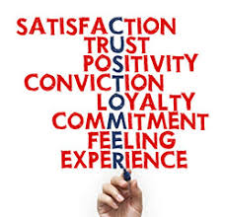
Sub-Topic (Example: name of college)
Notes:
“Customer is King” is no longer a valid saying. “Customer is Dictator” is the in saying!!!

Slide 4

Topic/Course
Notes:
If there is no Customer Centricity, the Company may end up in nothing, burning down to ashes.

Slide 5

The Seven Deadly Sins of Customer Centricity
Notes:
So, now let us look at what we need to “NOT” do. “The Seven Deadly Sins of Customer Centricity”.

Slide 6
The Seven Deadly Sins of Customer Centricity
NO CUSTOMER-CENTRIC VISION
NO OMNI-CHANNEL STRATEGY
NO MOBILE-FIRST PRESENCE
NO EMPLOYEE COMMITMENT
Notes:
We have to ensure that we never commit even one of the Seven Deadly Sins of Customer Centricity.

Slide 7
The Seven Deadly Sins of Customer Centricity
NO PROACTIVE APPROACH
NO LOYALTY STRATEGY
NO LISTENING METHOD
Notes:
Let us now look at each one of them.

Slide 8
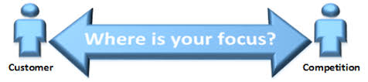
NO CUSTOMER-CENTRIC VISION
Sub-Topic (Example: name of college)
Notes:
The digital disruption has caused an evolution from passive consumers to demanding and informed customers. In the Age of the Customer, the experience is considered at least as important as the product or the brand itself. “Everything starts with the customer”.
The secret of a real customer-centric company lies in the ability to adopt a proactive approach and predict how clients' needs and desires will change as a result of technological innovation. Success only comes when customers become the core of your strategy.

Slide 9
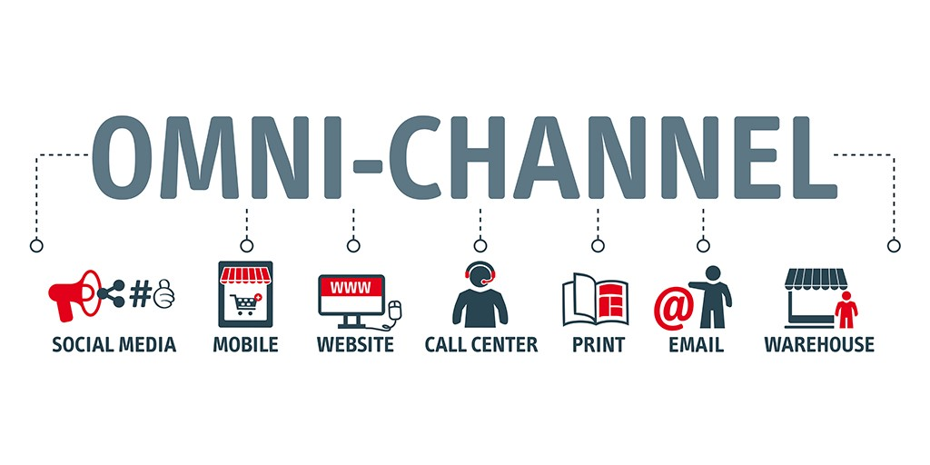
NO OMNI-CHANNEL STRATEGY
Notes:
Customers, involved in a mobile ecosystem, experience brands and products across different touch points, online and offline. In their purchase process they value the word-of-mouth but look for information on their devices (smartphone, tablet and soon smartwatch).
As a result, they don't live into one channel alone, and expect that you are able to engage them wherever they are, whenever they need it, whatever point of contact they are using. Thus, customer journey mapping becomes critical to understand in which ways people interact with brands and how to connect with them efficiently.

Slide 10
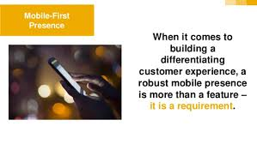
NO MOBILE-FIRST PRESENCE
Topic/Course
Sub-Topic (Example: name of college)
Notes:
Long gone are the days when mobile was 'just' a new way of communication, with no marketing purpose. The mobile disruption is rebooting the purchase process and - consequently - marketing and sales funnels. The Smartphone is now the first reference for product and service information: if your brand is not mobile-savvy, more than likely it won't be considered among their top choices.
Not being mobile is like not being at all. Still, too many companies fail to evolve with the times, while costumers run towards the future to become more and more empowered. The digital transformation requires that a mobile-first (if not mobile-only) attitude is the standard: a modus operandi, not a goal.

Slide 11
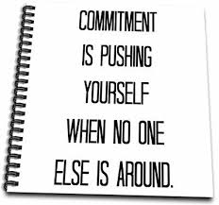
NO EMPLOYEE COMMITMENT
Sub-Topic (Example: name of college)
Notes:
According to recent studies, companies spend over 720 million dollars each year on employee engagement programs. This figure is destined to rise to over $1.5 billion in the next few years, yet actual engagement falls down to a mere 13%.
Digital leaders understand the importance of involving employees into their strategies because “the entire service-profit chain begins with, and absolutely depends on, engaged employees”. The real 'inner sin' occurs when: there are no shared vision and objectives; you still rely on a top down execution; you fail to deliver core values into an amazing customer experience.

Slide 12
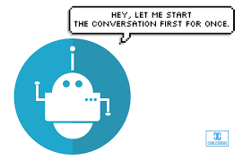
NO PROACTIVE APPROACH
Notes:
The emergence of powerful devices (virtual reality and iBeacon, to name two) forces all businesses to adopt different approaches to overcome the challenge of innovation. At the same time, brands can profit from the astonishing amount of data produced by technology and behaviours. Data about markets, competitors and - most of all - customers. A shapeless mass that they must learn to scan and transform into useful insights.
Once you know how to deal with the big data phenomenon, you will unlock the huge opportunities of a proactive approach to customer experience. Being proactive, you will be able to control the situation - acting rather than reacting -, to understand customers' needs, and to anticipate their questions and doubts before they even happen.

Slide 13
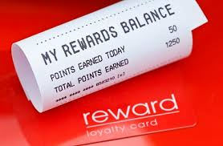
NO LOYALTY STRATEGY
Notes:
Single sales by new clients or repeat sales by devoted customers: What do you value the most? Far from saying that acquisition is not important, statistics prove that customer retention is way more crucial to succeed in the long term. One for all: the probability of selling to an existing client lies between 60 and 70%, but the probability of selling to a new customer is no more than 20%.
If the acquisition costs on average 6 times more than retention, it's easy to see why more and more brands are investing time and budgets in loyalty-focused programs and gamification mechanics. When customers can choose from thousands of suppliers from all over the world, you must conquer their heart and mind to an enduring success.

Slide 14

NO LISTENING METHOD
Notes:
Last but not least, a method sin: too many companies still assume that their relationship with customers is a top-down one-way communication. They think that customer service is separated from all other business functions and that they are in charge of the brand image. This may have been true in the pre-Internet era, but today things are completely different.
Your top priority, on the contrary, should be to listen and understand what customers think and want. Remember: they know you better than you do. Social media and real-time messaging make the perfect tool to foster the necessary two-ways communication and inside-out dynamics.
And yes, probably there are more than just 7 deadly sins for digital customer experience, but we think these are the most harmful for your marketing strategy health. It’s not too late, though, to regret and make amend: abandon the wrong way and you will finally offer a better experience.

Slide 15
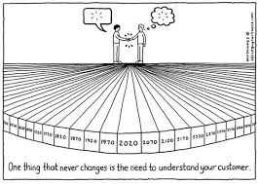
CUSTOMER CENTRICITY OR CUSTOMER FOCUS?
Notes:
CUSTOMER CENTRICITY!!! Why? We will discuss in the following slides.

Slide 16
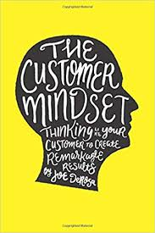
Thinking like a customer
Notes:
Customer-focused approaches tend to be based on looking at the customer and trying to work out what to sell to them. This is an outside-in approach. Customer-centric approaches try to see the world from the customer’s point of view, which is an inside-out point of view. Approaches like programmatic advertising, A/B testing and NPS metrics are customer focused. Approaches based on co-creation, ethnography, and motivations tend to be customer centric.
A/B testing is a way to compare two versions of a single variable, typically by testing a subject's response to variant A against variant B, and determining which of the two variants is more effective.
Net Promoter Score metrics: An NPS metric is created to measure company or product loyalty by sending out a survey asking your customers a single question: “On a scale of 0 to 10, how likely are you to recommend our company's product or service to a friend or colleague?” Based on their scores, customers are then classified into three categories: promoters, passives, and detractors.
Promoters score a 9 or a 10 and are considered loyal customers that will keep buying from your company and recommend to friends to do the same.
Passives score a 7 or an 8 and are considered satisfied but unenthusiastic customers who can be easily lured away by competitors.
Detractors score a 6 or lower on the scale and are considered unhappy customers who are a churn risk and spread the majority of the bad word of mouth advertising.

Slide 17
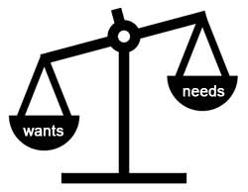
Dealing with needs, not wants
Notes:
Customer-focused companies listen to what customers say they want and try to give it to them. Customer-centric companies try to understand what customers need and deliver that. The famous examples of Ford not wanting to provide faster horse-drawn carriages and Steve Jobs not asking customers how to develop the iPhone fall into this category.

Slide 18

Provide solutions, not just products/services
Notes:
Customer-focused marketing tries to identify which products and services match the wants from each customer. Customer-centric approaches try to create a complete solution. By thinking like the customer, by understanding needs as well as wants, a customer-centric company can ensure that the long-term experience of the customer is optimized.

Slide 19
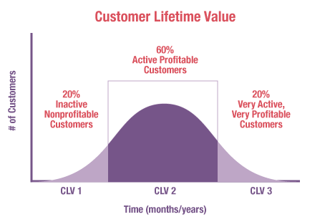
Focus on Customer Lifetime Value
Notes:
Customer-focused companies often focus on being nice to all their customers, offering great service to all customers and empowering frontline staff to go the extra mile to make the customer happy. Customer-centric companies know who the key customers are, because they employ an approach based on customer lifetime value. These companies typically have a segmentation that is based on customer lifetime value, and focus their efforts on the relationship with and needs of these customers. Other customers are still customers, but they are not central to the strategic planning of the business, nor to the creation of the key tactical tools.

Slide 20
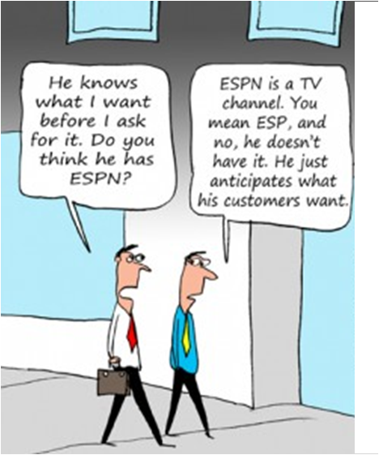
Proactive instead of reactive
Notes:
Extrasensory perception or ESP, also called sixth sense, includes claimed reception of information not gained through the recognized physical senses, but sensed with the mind.
Customer-focused companies tend to chase the customer, seeking to please everybody who walks through the door and seeking to match the product/services on sale with each customer. Customer-centric companies are focusing on core customer groups, identifying needs (not just wants), and seeking to solve problems. This is a strategic approach and encourages the company to work with customers to co-create the future.
Peter Fader, author of Customer Centricity, summarizes the picture in the following way: "Customer centricity is a strategy to fundamentally align a company’s products and services with the wants and needs of its most valuable customers."

Slide 21

Examples of Customer Centricity
Notes:
Best Buy Co., Inc. is an American multinational consumer electronics retailer headquartered in Richfield, Minnesota. It was originally founded by Richard M. Schulze and James Wheeler in 1966 as an audio specialty store called Sound of Music.
Trainer to explain the below example:
Ranjay Gulati reports how Best Buy talked to a group of customers (in this case "Busy moms") to find out why they were leaving the store without buying anything. One of the drivers of selecting this group was that women are involved in 55% of purchases from the store—i.e. they are a high-value group.
Best Buy discovered there was a mismatch between the sort of "customer focus" the sales team were offering and the actual customer needs. These "busy moms" wanted to look at complete solutions such as wanting to buy a digital camera that would allow them to share photos with family members. But the sales team were immediately diving into questions about the number of pixels the shopper wanted. By identifying important customer groups and then identifying customer needs, Best Buy was able to sell more stuff, and sell the right stuff. Gulati reports that the customer-centric layout that resulted from the initiative led to a 9% increase in sales.

Slide 22
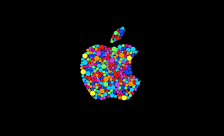

Examples of Customer Centricity
Notes:
Everyone knows Apple and Nokia.
Apple Inc. is an American multinational technology company headquartered in Cupertino, California, that designs, develops, and sells consumer electronics, computer software, and online services. It is considered one of the Big Four technology companies, along with Amazon, Google, and Facebook.
Nokia Corporation is a Finnish multinational telecommunications, information technology, and consumer electronics company, founded in 1865. Nokia's headquarters are in Espoo, in the greater Helsinki metropolitan area.
Trainer to explain the below example:
In 2007, Nokia was the dominant mobile phone provider, with a global share of about 50%. Nokia had a great research program and was listening to what their customers wanted and seeking to satisfy all of their customers.
By contrast, Steve Jobs and Apple launched the iPhone, which addressed the needs of core future customers. The iPhone never reached a market share of 50%, but was massively profitable and fundamentally disrupted the mobile phone market—leading to the decline of Nokia. Although Apple does conduct market research, it has been successful by anticipating needs and by focusing on customer lifetime value among its core segments. Apple is customer centric, but it is not customer friendly or focused (unless you happen to fit one of their core groups).

Slide 23

Examples of Customer Centricity
Notes:
Ryanair DAC is an Irish budget airline founded in 1984, headquartered in Swords, Dublin, Ireland, with its primary operational bases at Dublin and London Stansted airports. It forms the largest part of the Ryanair Holdings family of airlines, and has Ryanair UK, Ryanair Sun, Malta Air and Lauda as sister airlines.
Trainer to explain the below example:
Ryanair is a very successful low-cost airline in Europe. It is also rated very badly by industry satisfaction studies. In 2017 the Which survey rated it worst amongst 20 European airlines—while acknowledging that it was also Europe’s most popular airline (i.e. it had the highest number of customers).
Ryanair is not a customer friendly sort of brand, but it is customer centric. It flies lots of planes, reliably, to lots of destinations, at very low cost. Their target customers are the people whose needs are price, frequency and destination. These customers might "want" good food, pleasant customer service, free additions etc.—but they are not prepared to pay for it. Ryanair has succeeded by identifying and focusing on the needs of its customers, not by trying to please everybody.

Slide 24
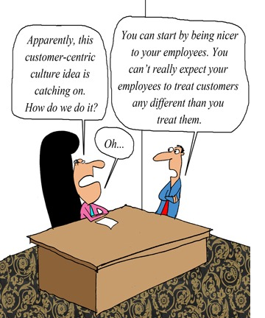
Customer Centricity in Business
Notes:
The first step is to start thinking strategically, and being proactive rather than reactive.
Determine how you are going to focus on lifetime customer value, in particular, who your core customers will be. Focus on customer needs rather than wants (you will still research and respond to wants, but needs are key). Organize around providing solutions, rather than separate collections of products or services.
Decide how you are going to start seeing the world through the eyes of the customer, rather than just watching the customer.
Above all, remember that your employees are the ones dealing with your customers. So, treat your employees well and they will treat your customers well in return.

Slide 25
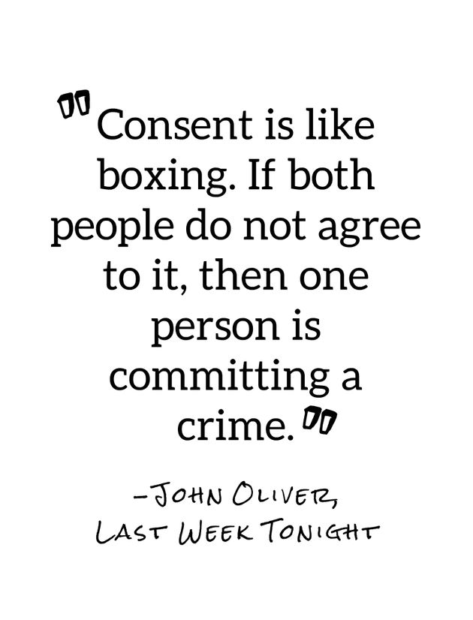
Consent
Notes:
Start with “Earning Consent”:
A core tenet of any customer-centric business is establishing consent to use your customers’ data. Cookies are on their way out. Passive “you agree to our terms” statements will face a certain, deserved death. Adding a boilerplate consent form to your website is simply not enough for customers to trust your business with their data.
There must be clarity and integrity behind customer consent to data collection. And customers must see the value in sharing their data with a business in the first place. Customers now expect to understand exactly why they are being asked for their data and to what they are actually consenting.
Try forging that connection with customers the Condé way. Condé Nast has shown its dedication to its customers by building a hub that encourages customers to share data by delivering intrinsic value and personalized benefits when consent is given. The global media company’s hub is a critical tool that opens the door to their one billion readers. This unique approach to engaging and understanding customers helps Condé personalize the customer journey. These actions by Condé are breakthroughs in what the world is starting to call zero-party data.
Condé Systems is the largest supplier of sublimation technology in the world. 27 years in business supplying sublimation blanks, sublimation printers, heat press machines, sublimation inks and more.

Slide 26
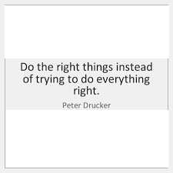
Customer Data
Notes:
Make it easier to do the “Right Things” with “Customer Data”:
Right now, it is still easier to do the wrong things with customer data.
Most organizations were built to collect and use customer data before requirements for consent became so prescriptive.
These legacy systems are in place. Skills to use those systems have been developed. Significant investments have been made, and budgets for change are limited. That is a lot of inertia.
We all want a quick fix, but one is not there. Until we embrace doing the hard things necessary to understand the customer on the customer’s terms, we are just giving lip service to customer-centricity.
At Vision Critical, they continuously engage their own customers to understand how they can help them transform customer data collection and application in their organizations. Most of the guidance they get is to “make it easier” to do the right thing.
Vision Critical provides a cloud-based customer intelligence platform that allows companies to build engaged, secure communities of customers. Based in Vancouver, the company was founded by Andrew Reid in 2000 and works with over 700 global brands around the world.

Slide 27
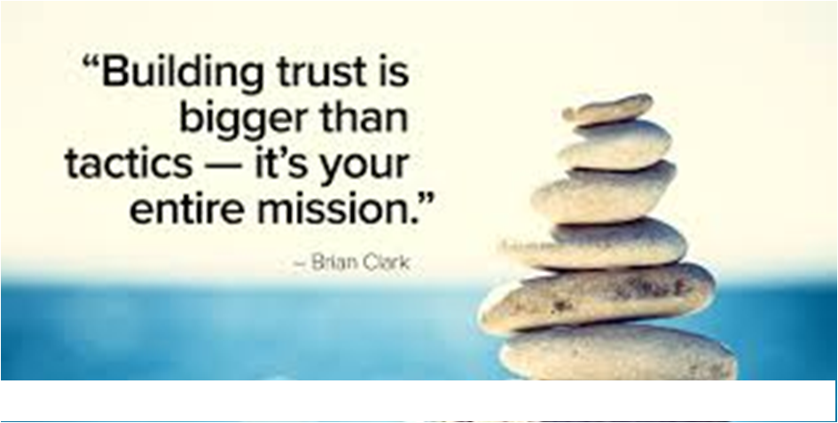
Build Trust
Notes:
Tear down “Silos” to “Build Trust Internally”:
There is a vacuum of customer data beyond the teams that collect it for their own departmental use. Valuable data are collected, but data and associated insight are inaccessible to critical stakeholders in other divisions or departments. Sometimes silos can remain from a previous organizational structure; but in many cases, these silos are created, intentionally by a department or team, in order to control the data they have collected.
In customer-centric organizations, these silos are being torn down at a rapid pace. Business leaders get it. Virtually everyone in their organization can benefit from a better understanding of the customer.
At Vision Critical, they have rebuilt their data layer in order to democratize the consent data they help organizations collect. As a result, consent data and customer insights are moving quickly into the hands of teams that need them, helping leaders break down the silos while simultaneously caring for the collected customer data according to the latest privacy and security standards.
Silos: It occurs when departments or management groups do not share information, goals, tools, priorities and processes with other departments. The silo mentality is believed to impact operations, reduce employee morale and may contribute to the overall failure of a company or its products and culture.

Slide 28

Do the Hard Things
Notes:
A customer-centric organization must make data available to the systems and people who are making decisions and driving execution, all while balancing personalization and privacy. Scaling and securing data are arduous tasks that yield a wealth of value that goes mostly unnoticed.
It is hard to invest millions in a benefit that everyone needs, but that is not visible to the uninformed eye.
It is also hard to inspire people to democratize data when they know that their personal interests may be better served by keeping those data in isolation. Just know that there are fantastic by-products from doing it right.
Use of consent data increases profits 8–10% and reduces costs 10%. (Entrepreneur, 2019).
The lifetime value of the customer relationships increases by up to 25%.
The impact of deeper understanding creates better understanding/segmentation/product development, all leading to improved personalization of experiences.
Specifically, Southern Cross Austereo found that consenting customers proactively contribute twice the content when responding to surveys.
On average, customers who consent to join an insight community actively share their data 13 times a year for more than three years of continuous engagement. Again, that is just the historical average and more customers are exceeding it every day.
The Benefits Keep Coming:
When you put in the effort to properly get to know someone and something, you know everything.
When looking at breakthroughs in data, from understanding the human genome strain to the acceleration of the science of individuality, there is fervent excitement about the potential for those who commit to doing the right things. Proper use of customer data—that which simultaneously informs business and delivers real benefits back to the people who are the source—is the foundation for a successful, bold customer-centric brand.
How are you tackling the hard stuff and building a bold customer-centric brand by earning consent for your zero-party data?
Southern Cross Austereo is an Australian group of companies formed in July 2011 by the merger of Southern Cross Media Group and Austereo Group. The Group's parent company, Southern Cross Media Group Limited, is listed on the Australian Stock Exchange.

Slide 29
Activity
As a customer
What is your expectation in terms of customer centric as a customer?
Elaborate from your own experience
Assume that you are engaged in a business and you have to deal with customers.
What are the steps you will take for making your business as a customer centric?
Explain your answers
Notes:
Activity time : 10 minutes
Trainer has to give the above 2 situations one by one.
Start the activity and get responses for the 1st question for 5 minutes
After 5 minutes, provide the 2nd question and get the responses from the students for 5 minutes.

Slide 30
RECAP ANYONE ?
Notes:
Trainer to ask anyone to re- cap.

Slide 31
RECAP ANYONE ?
The Seven Deadly Sins of Customer Centricity:
NO CUSTOMER-CENTRIC VISION
NO OMNI-CHANNEL STRATEGY
NO MOBILE-FIRST PRESENCE
NO EMPLOYEE COMMITMENT
NO PROACTIVE APPROACH
NO LOYALTY STRATEGY
NO LISTENING METHOD
Notes:
If any points were left out in the re- cap, Trainer to mention the same and then do a Final Re- Cap.

Slide 32
RECAP ANYONE ?
CUSTOMER CENTRICITY OR CUSTOMER FOCUS?
Thinking like a customer
Dealing with needs, not wants
Provide solutions, not just products/services
Focus on Customer Lifetime Value
Proactive instead of reactive
Notes:
If any points were left out in the re- cap, Trainer to mention the same and then do a Final Re- Cap.

Slide 33
RECAP ANYONE ?
Customer Centricity in Business
Consent
Customer Data
Build Trust
Do the Hard Things
Notes:
If any points were left out in the re- cap, Trainer to mention the same and then do a Final Re- Cap.

Slide 34
Activity
Give Reasons Why A Faulty Experience May Be Offered To Mobile Customers.
Notes:
Trainer to Elicit Responses from Students.
Examples:
You don’t have a mobile presence: this is level zero. You don't have an app, your website is not responsive or adaptive, you never update your social pages.
You site is not responsive: you have a website, yet it's all but mobile-friendly. It was made to work on a desktop computer, and it fails to deliver a fulfilling experience to users in mobility.
You have a faulty app: they might be a necessary part of your digital strategy, but faulty - or not working at all - apps could only do harm to your brand perception. Find the right partner and develop a huge app experience.
You don’t offer unique content: companies are now able to locate and target individuals who are significantly qualified, to create content marketing customized with context. If your strategy is not location-savvy, then you're missing a piece.
You give a lousy User Experience: the user experience involves practical and emotional aspects of the interaction between the user and your digital product.
You don't optimize landing pages: if you're investing time and budget in inbound marketing tactics and online advertising, make sure you optimize your landing pages. They're the first place users land on, the first contact they have with your brand.
You don't offer payment options: the conversion path will always be incomplete and inefficient if your payment process is slow, unclear and time-costly. Your customer journey must offer different solutions to pay in a seamless, easy and secure way.
You don’t personalize offers: personalization is the key to success in the digital era. You can rely on big data to understand customers and markets: use those numbers to offer unique experiences and personal deals.
You don’t think omni-channel: you are not judged for what you sell, but for the whole journey you create to connect products and clients. An omni-channel experience is a reflection of how our life has evolved in the mobile era, a foundational element of digital customer engagement.
You don't play with customers: More and more companies focus on gamification mechanics to enhance loyalty. Games are everywhere, and you need to learn the rules of gamification to engage customers playing with them.

Slide 35

THANK YOU
Notes:
Trainer to Thank the Students saying that it was a good session and re- iterate the usefulness of the session.

